Slide 1
Project Title
TechCo
Submitted to:
Department of Computer Applications
Submitted by:
Rahul Prashar
Akshay
Gaurish
Gurjot

Slide 2
Brief Overview:
TechCO is a software company that positions itself as a team of innovators focused on transforming businesses through technology. our mission is to craft scalable, secure, and user-centric software solutions to help businesses succeed in the digital age. The company's profile highlights a team of expert developers, visionary designers, and strategic thinkers committed to excellence and transparency

Slide 3
Problem Statement :
In today's digital-first economy, a technology company without a robust online platform faces significant barriers to growth. The core problem is the inability to establish market credibility, effectively showcase complex technical services, and attract both new clients and skilled employees. Without a central digital hub, the company struggles with:
*Lack of Visibility and Trust: Potential clients have no way to verify the company's legitimacy, view its offerings, or understand itsmission.
*Ineffective Lead Generation: There is no clear or scalable method for interested customers to learn about service costs or make inquiries. *Inefficient Recruitment Process: The company cannot easily broadcast job openings or streamline the application process, making it difficult to attract top talent.

Slide 4
Proposed Solution
The TechCO website directly addresses the problem statement by implementing a series of targeted solutions, each corresponding to a specific challenge:
Solution for Credibility: The website features a professional "Our Profile" page explaining who the company is and a "Meet Our Team Members" section to build trust and showcase expertise.
Solution for Showcasing Services: A dedicated "Our Products & Services" page clearly outlines the three main service pillars, allowing potential clients to easily understand the company's capabilities.
Solution for Lead Generation: The "Flexible Pricing Plans" page provides clear, tiered options for different business sizes.The "Business" plan is highlighted as the most popular choice, and an Enterprise-level "Contact Us" option serves as a direct channel for high-value leads.
Solution for Recruitment:* The "Career Opportunities" page acts as a complete talent acquisition portal. It lists current openings like "Senior Frontend Developer" and "Cloud Security Engineer" and features an "Apply Now" form where candidates can enter their name, email, phone number, and position preference.

Slide 5
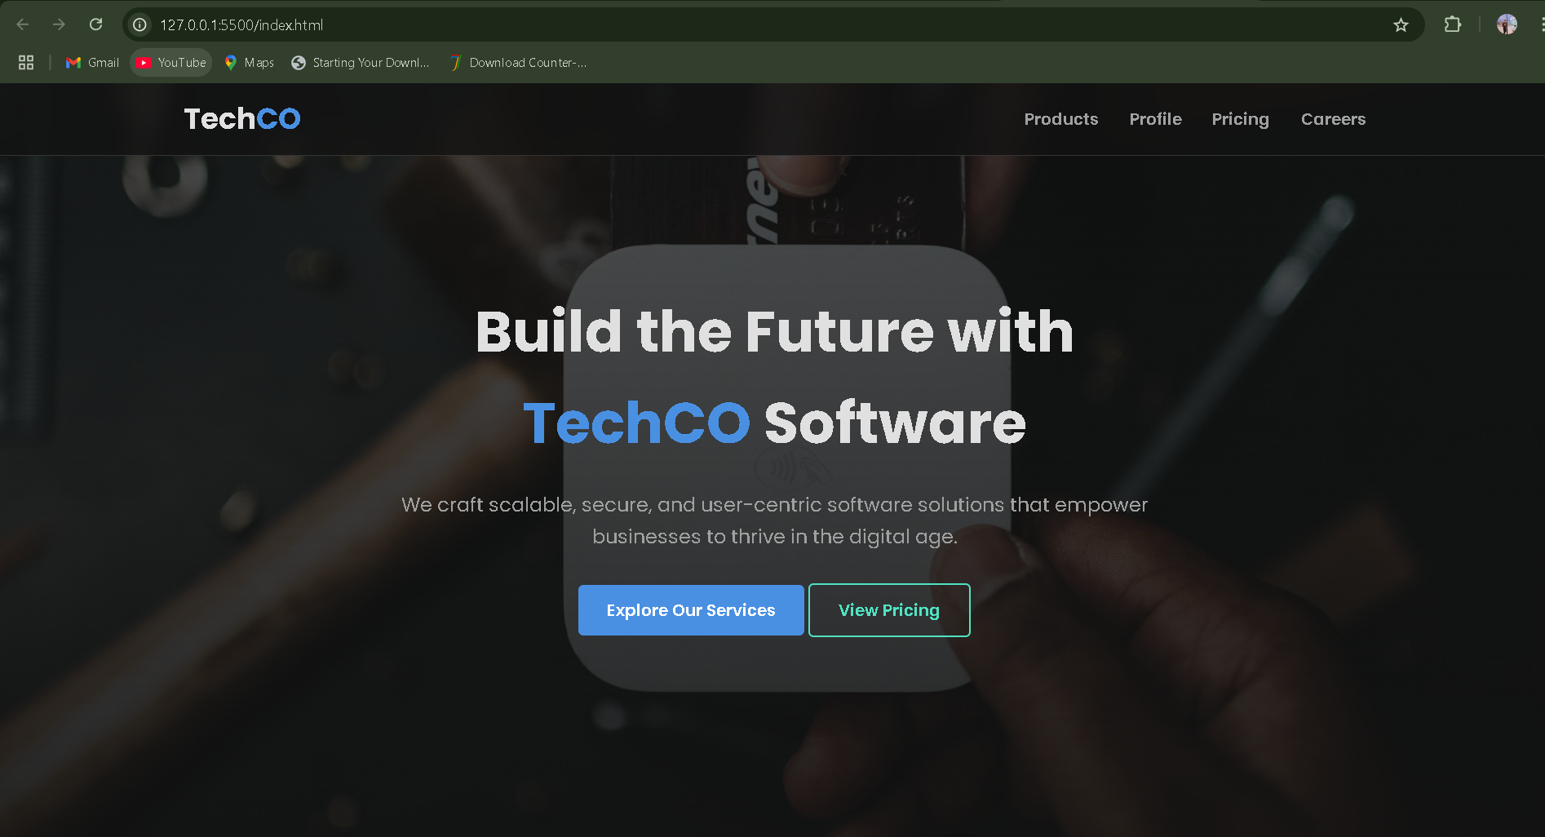
A Glimpse of Our Website

Slide 6
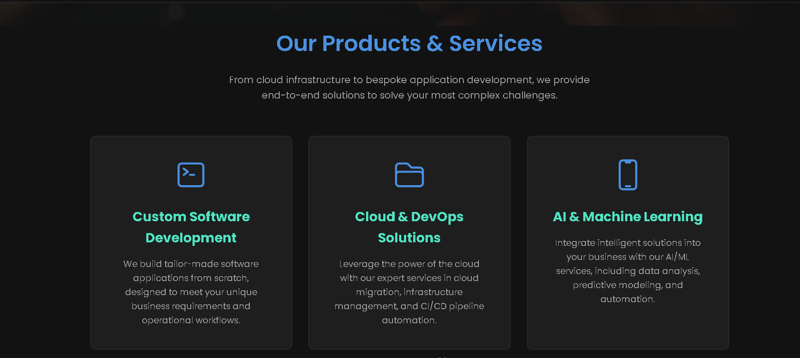

Slide 7
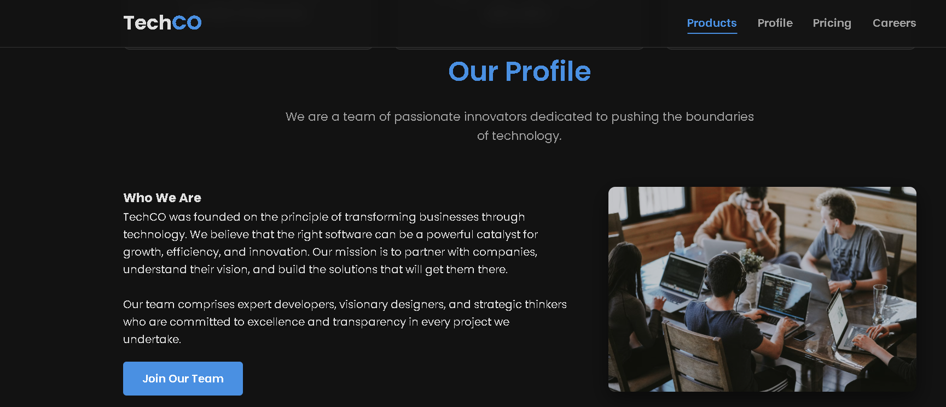
Key Observations:
Establish a Professional Online Presence
Clearly Define Service Offerings
Showcase Company Identity and Team
Implement a Transparent Pricing Model
Facilitate Talent Acquisition

Slide 8
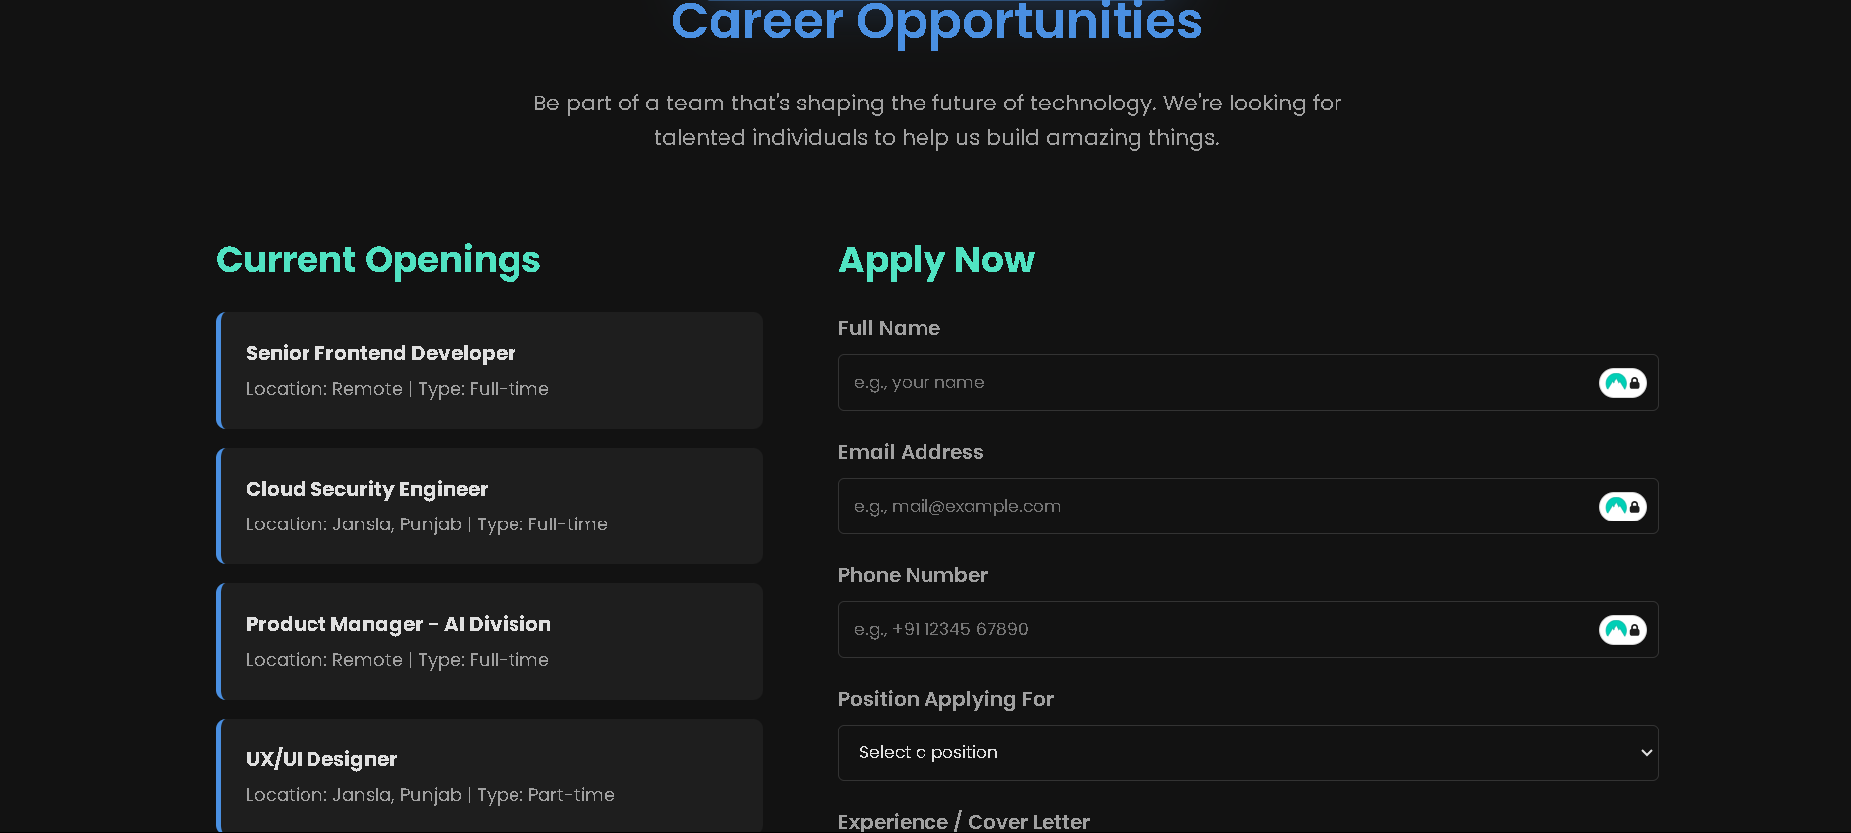

Slide 9
Conclusion & Future Scope:
Conclusion:
This project successfully achieved its objective of developing a fully-featured website for the tech company, TechCO. The final product is not just a digital brochure but a strategic tool that solves critical business problems. The website effectively establishes a strong brand identity, clearly communicates the company's value to clients, and streamlines the recruitment process. By integrating essential elements like a detailed service breakdown, transparent pricing, and a functional careers page, the TechCO website serves as a foundational asset that directly supports client acquisition and company growth.
Future Scope:
Expansion of AI Services
Specialization in Cloud Security
Scaling Client Acquisition
Geographic and Team Growth
Final Note:
The TechCO website is more than just a digital presence; it's a strategic asset engineered for growth. It successfully translates the company's vision and capabilities into a platform that builds credibility, generates leads, and attracts top talent. By seamlessly integrating detailed service descriptions , a clear pricing structure , and a functional careers portal, the project serves as a powerful engine for business development. This website positions TechCO as a credible and forward-thinking competitor in the technology industry, ready for future expansion

Slide 10
THANK YOU

